Slide 1
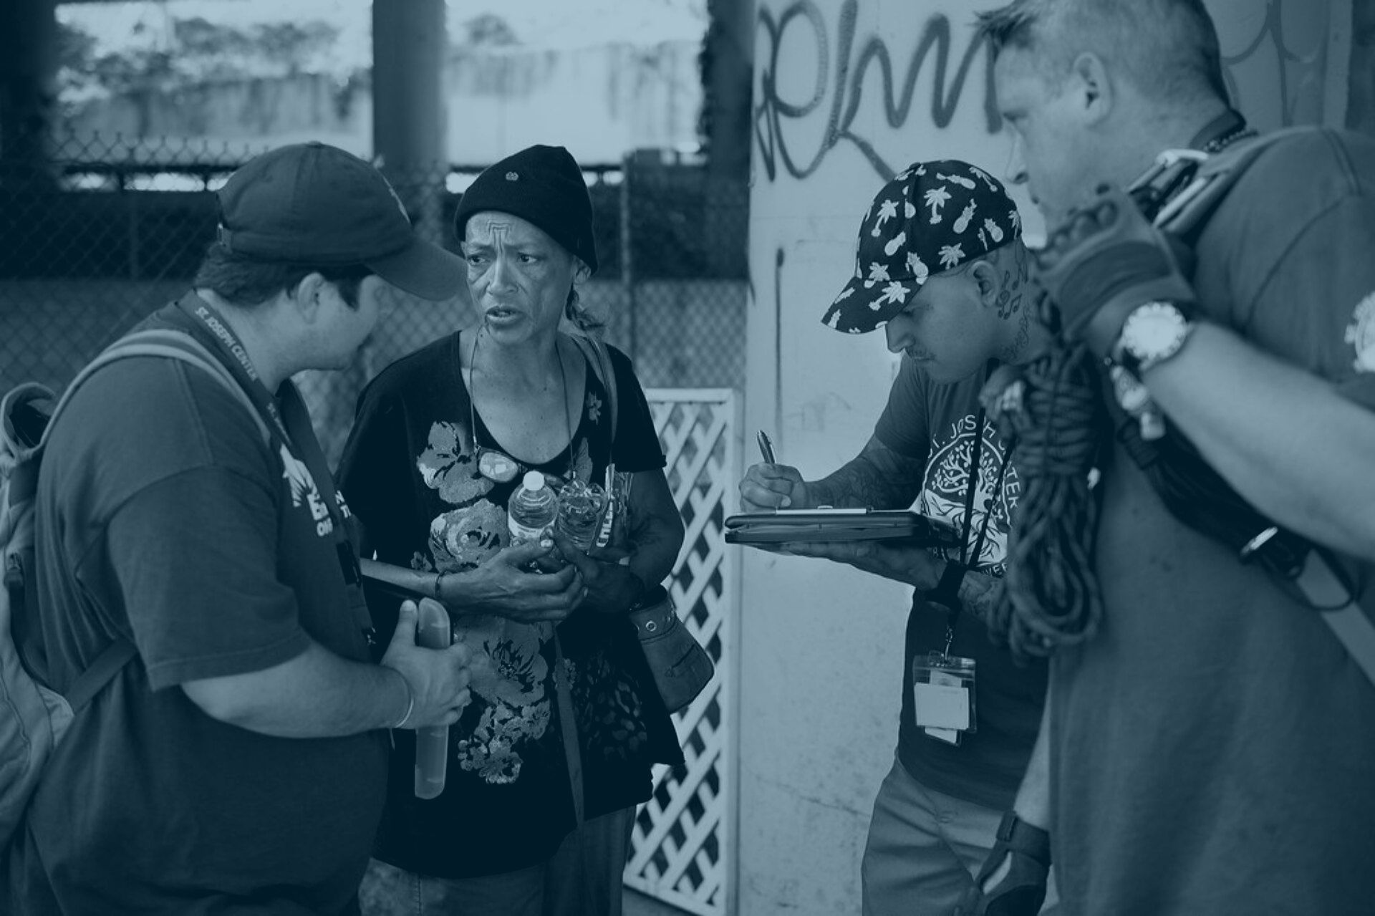


Greater Los Angeles
Homeless Count
2019 Results
Updated June 5, 2019

Slide 2
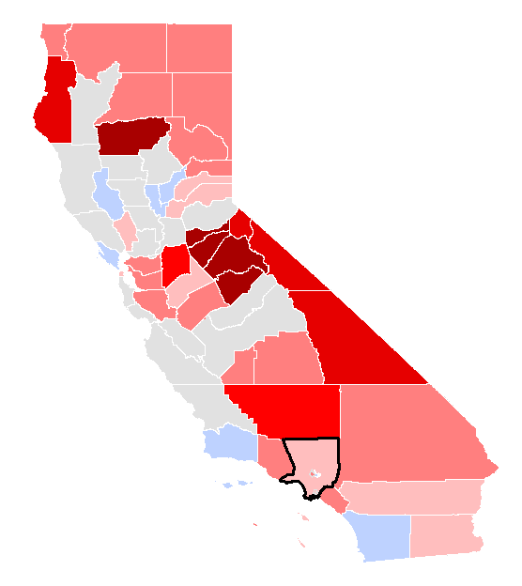

The affordable housing crisis is driving a regional increase in homelessness
Percent Change for CA Continuums of Care between 2017 and 2019 Homeless Counts
100%
75% - 99%
  Rising homelessness is a statewide challenge
  The simple average increase among reporting areas statewide is +35%
  LA is the least affordable housing market in the United States*
50% - 74%
25% - 49%
1% - 24%
0%- Decrease
No data
*Joint Center for Housing Studies of Harvard University, “The State of the Nation’s Housing” 2018

Slide 3




Economic factors are driving increases in homelessness
Wages have not kept pace with rental cost
721,000 LA County households are severely rent-burdened**
LA needs 516,946
new affordable
housing units
An LA renter earning minimum wage ($13.25/hr) would need to work 79 hours per week to afford rent on a 1-bedroom apartment*
1/3 of LA households spend more than 50% of their household income on rent
To meet the needs of low-
income renters***
*The Federal Home Loan Mortgage Corporation, “Rental Burden by Metro” 2019
* *Joint Center for Housing Studies of Harvard University, “The State of the Nation’s Housing” 2018
***California Housing Partnership Corporation. (May 2019) Los Angeles County Annual Affordable Housing Outcomes Report.
Notes:
PL -I’m not sure that the first box data is still current – two years out of date

Slide 4









We housed more people than ever, yet our housing affordability crisis drove a net rise in homelessness
721,000
Severely rent-burdened LA households
5,643 people prevented from entering homelessness
54,882
Estimated inflow over 2018
52,765
58,936
2018 Point-in-time count
2019 Point-in-time count
21,631
27,080
People placed in homes
Estimated other exits to housing

Slide 5
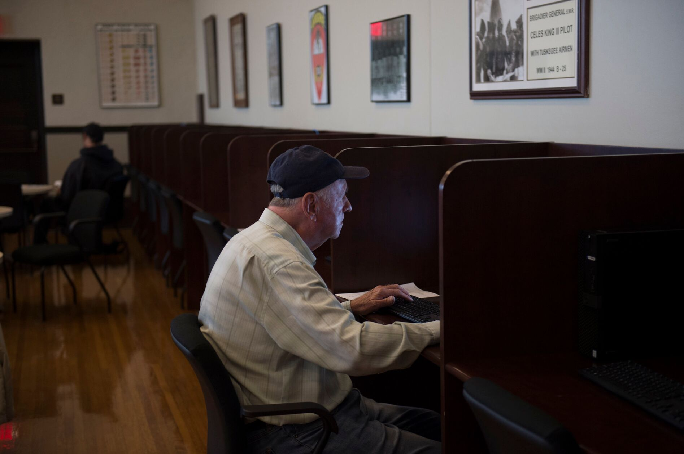

Senior homelessness increased by 8%
Population aged 62+
LA CoC*
KEY FACTS:
  Workgroup of government agencies and community partners to strengthen LA County's response for seniors
  Outreach at senior centers and senior meal sites
  Legal assistance and temporary rental subsidies to help seniors stay in their homes
  Partnership with Adult Protective Services
  150 new older adults interim housing beds
​
*LA CoC excludes Glendale, Pasadena, and Long Beach CoCs

